Slide 1


Slide 2
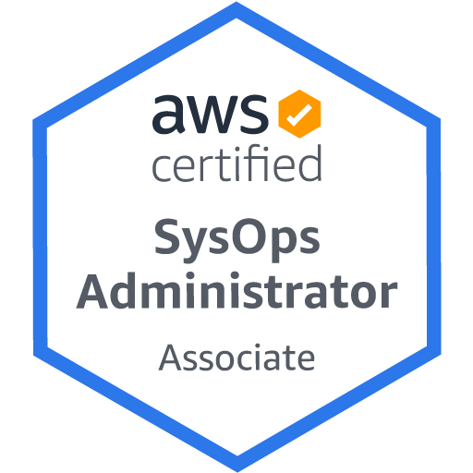


Instructor : Thiều Lâm Đông Quân Account : QuanTLD Moblie : 0907 009 599 Mail : QuanTLD@fsoft.com.vn

Slide 3
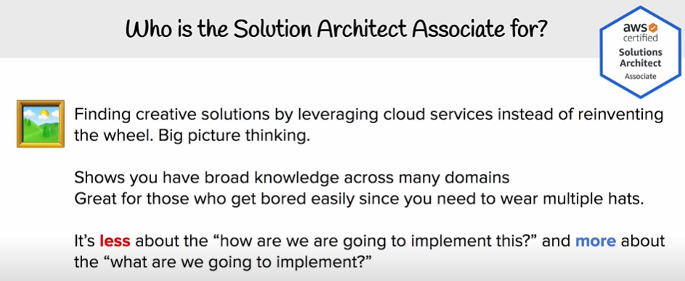

Slide 4
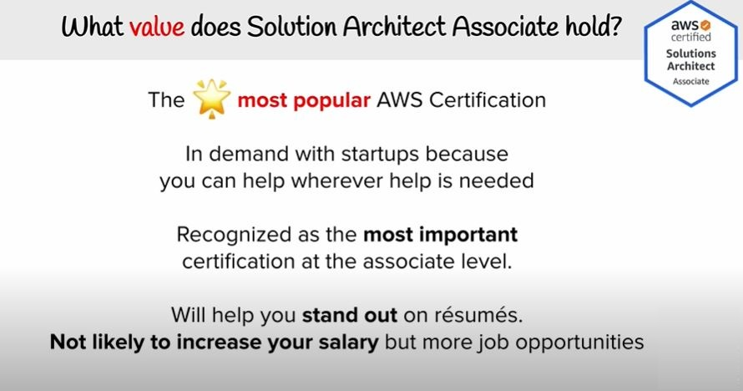

Slide 5
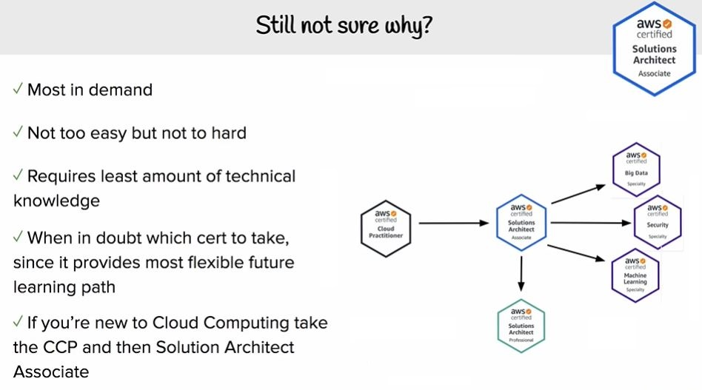

Slide 6

OVERVIEW

Slide 7
Table of Contents
What is “Cloud Computing”?
The Differences that Distinguish AWS
AWS Reference Model
AWS Shared Responsibility Model
AWS Training & Certification
Getting Started With AWS

Slide 8
What is Cloud Computing?

Slide 9


Cloud computing is the on-demand delivery of compute power, database storage, applications, and other IT resources through a cloud services platform via the internet with pay-as-you-go pricing.

Slide 10
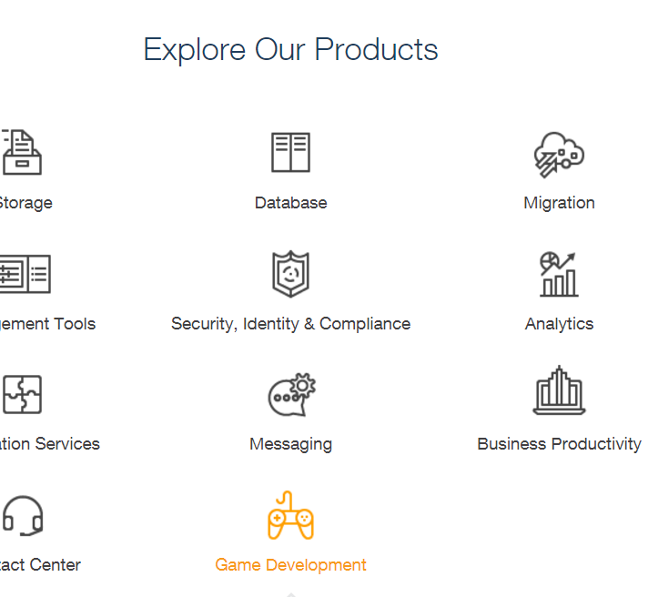
What Exactly Is Amazon Web Service?
Amazon Web Services is a secure cloud services platform with over 100 different services that include solutions.

Slide 11
The Differences that Distinguish AWS
Notes:
Hi gió vs CMC cloud vs Azure vs AWS

Slide 12
The Differences that Distinguish AWS
Flexible
Cost-effective
Scalable and elastic
Secure
Experienced
Notes:
Linh hoat
Hiệu quả chi phí
Dễ mở rộng và co giãn
Đảm bảo
Kinh nghiệm

Slide 13
AWS Reference Model

Slide 14
AWS Reference Model
Deployment & Administrator
App Services
Compute
Storage
Database
Networking
AWS Global Infrastructure

Slide 15
AWS Global Infrastructure
Deployment & Administrator
Data Center:
A single data center typically houses several thousands of servers.
App Services
Availability Zone:
Availability Zones consist of one or more discrete data centers, each with redundant power, networking and connectivity, housed in separate facilities.
Compute
Storage
Database
Networking
Regions:
A Region is a physical location in the world where we have multiple Availability Zones. Communicate between regions use public Internet Infrastructure.
AWS Global Infrastructure

Slide 16
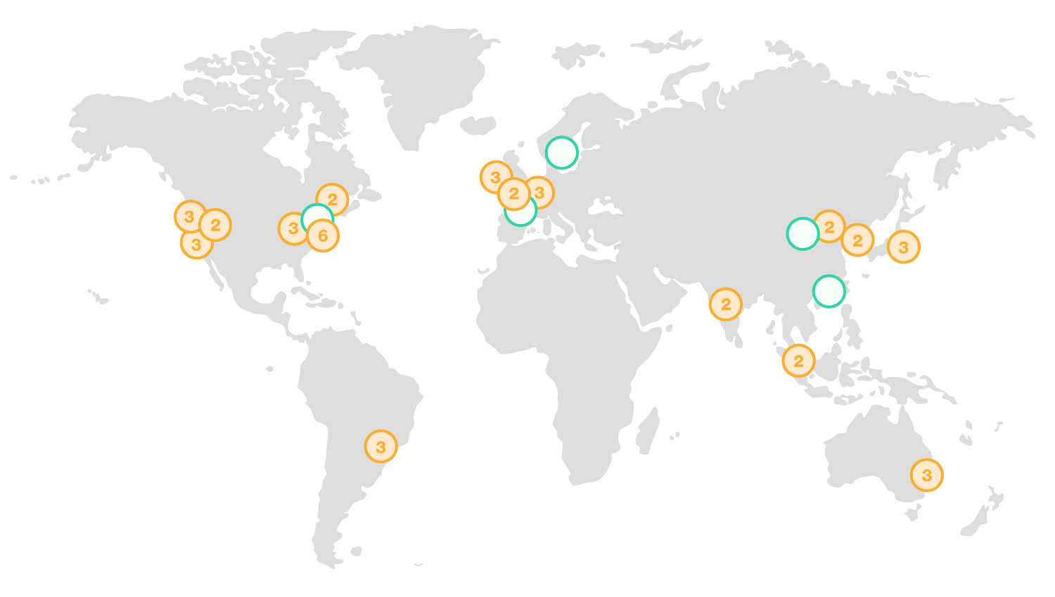
AWS Global Infrastructure
The AWS Cloud spans 61 Availability Zones within 20 geographic regions around the world, with announced plans for 12 more Availability Zones and four more AWS Regions in Bahrain, Cape Town, Hong Kong SAR, and Milan.

Slide 17
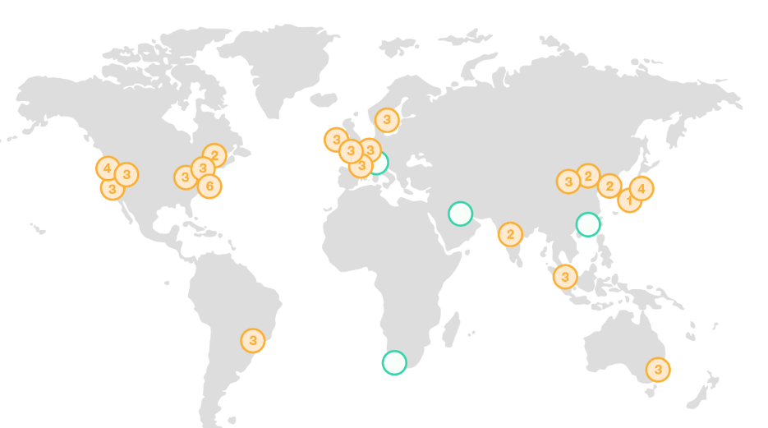
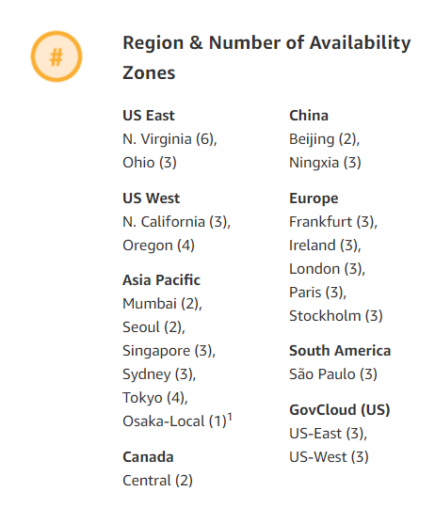

AWS Global Infrastructure

Slide 18




Networking
AWS Route 53
is a reliable and cost-effective managed Cloud based Domain Name System (DNS) web service that translates domain names into numeric IP
Route53
VPC
Direct
Connect
Elastic Load Balancing
Elastic Load balancing:
Elastic Load Balancing distributes incoming application traffic across multiple EC2 instances, in multiple Availability Zones. This increases the fault tolerance of your applications.
Deployment & Administrator
App Services
Direct connect:
dedicated network connection from your premises to AWS.
Compute
Storage
Database
Virtual Private Cloud:
a logically isolated section of the Amazon Web Services (AWS) cloud where you can launch AWS resources in a virtual network that you define.
Networking
AWS Global Infrastructure

Slide 19
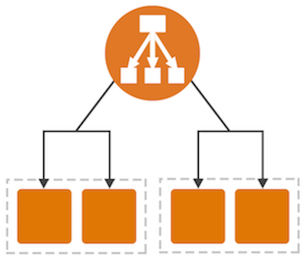
Networking
Elastic Load Balancing
Elastic Load Balancing automatically distributes incoming application traffic across multiple Amazon EC2 instances.
Elastic Load Balancing supports two types of load balancers: Application Load Balancers and Classic Load Balancers. Choose the load balancer type that meets your needs.
Benefit
Available
Elastic
Secure
Notes:
Available
Achieve higher levels of fault tolerance for your applications by using Elastic Load Balancing to automatically route traffic across multiple instances and multiple Availability Zones. Elastic Load Balancing ensures that only healthy Amazon EC2 instances receive traffic by detecting unhealthy instances and rerouting traffic across the remaining healthy instances.
Elastic
Elastic Load Balancing automatically scales its request handling capacity to meet the demands of application traffic. Additionally, Elastic Load Balancing offers integration with Auto Scaling to ensure that you have back-end capacity to meet varying levels of traffic levels without requiring manual intervention.
Secure
Elastic Load Balancing works with Amazon Virtual Private Cloud (VPC) to provide robust networking and security features
You can implement a multi-tiered architecture using internal and internet-facing load balancers to route traffic between application tiers. With this multi-tier architecture, your application infrastructure can use private IP addresses and security groups, allowing you to expose only the internet-facing tier with public IP addresses.
Elastic Load Balancing provides integrated certificate management and SSL decryption

Slide 20



Compute
Elastic Compute Cloud (EC2):
a web service that provides secure, resizable compute capacity in the cloud.
EC2
Auto Scaling
Lambda
Auto Scaling:
Automatically launch or terminate EC2 instances based on user-defined policies, health status checks, and schedules
Deployment & Administrator
App Services
Lambda:
AWS Lambda is a zero-administration compute platform for back-end web developers that runs your code for you in the AWS cloud and provides you with a fine-grained pricing structure.
Compute
Storage
Database
Networking
AWS Global Infrastructure

Slide 21
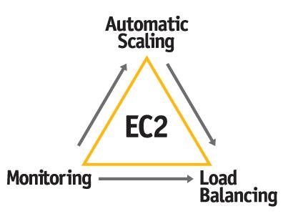
Compute
Elastic Compute Cloud
Ec2 offers Virtual computing Environment (Instances) you can launch and manage with a few clicks of mouse or few lines of code.
Benefit:
Elastic Web-Scale Computing ,Completely Controlled
Flexible Cloud Hosting Services , Integrated
Reliable ,Secure
Inexpensive
Easy to Start
Notes:
Benefit
Detail
Elastic Web-Scale Computing
Amazon EC2 enables you to increase or decrease capacity within minutes, not hours or days.
Completely Controlled
You have complete control of your instances including root access and the ability to interact with them as you would any machine.
Flexible Cloud Hosting Services
You have the choice of multiple instance types, operating systems, and software packages. Amazon EC2 allows you to select a configuration of memory, CPU, instance storage, and the boot partition size that is optimal for your choice of operating system and application.
Integrated
Amazon EC2 is integrated with most AWS services
Reliable
Amazon EC2 offers a highly reliable environment where replacement instances can be rapidly and predictably commissioned.
Secure
Full firewall control and security group
Inexpensive
Ondemand, reserved, spot instance
Easy to start
There are several ways to get started with Amazon EC2. You can use the AWS Management Console, the AWS Command Line Tools (CLI), or AWS SDKs.

Slide 22
EC2 pricing option
 | On demand instances | Reserved instances | Spot instances
Term | pay as you go | One year or three year | bid on unused capacity; instances can be lost if you outbid
Benefit | low cost and flexibility | predictability ensure compute capacity is available when need | large scale, dynamic workload
Cost | pay for what you use | pay low or no upfront fee; overall cost is lower | spot price base on supply and demand

Slide 23
EC2 Pricing Fundamental
Compute:
Clock hour of server time
instance type
purchase type
OS and software package
Block storage
additional storage, backup, data transfer
Load balancing
data processing
detailed monitoring
EIP
Data transfer
Regional data transfer
data transfer out

Slide 24
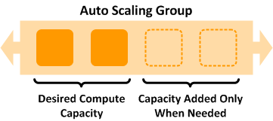
Compute
Auto scaling
Auto Scaling helps you maintain application availability and allows you to dynamically scale your Amazon EC2 capacity up or down automatically according to conditions you define. When you use Auto Scaling, your applications gain the following
Benefits:
Better fault tolerance.
Better availability.
Better cost management.
Notes:
Better fault tolerance. Auto Scaling can detect when an instance is unhealthy, terminate it, and launch an instance to replace it. You can also configure Auto Scaling to use multiple Availability Zones. If one Availability Zone becomes unavailable, Auto Scaling can launch instances in another one to compensate.
Better availability. Auto Scaling can help you ensure that your application always has the right amount of capacity to handle the current traffic demands.
Better cost management. Auto Scaling can dynamically increase and decrease capacity as needed. Because you pay for the EC2 instances you use, you save money by launching instances when they are actually needed and terminating them when they aren't needed.

Slide 25


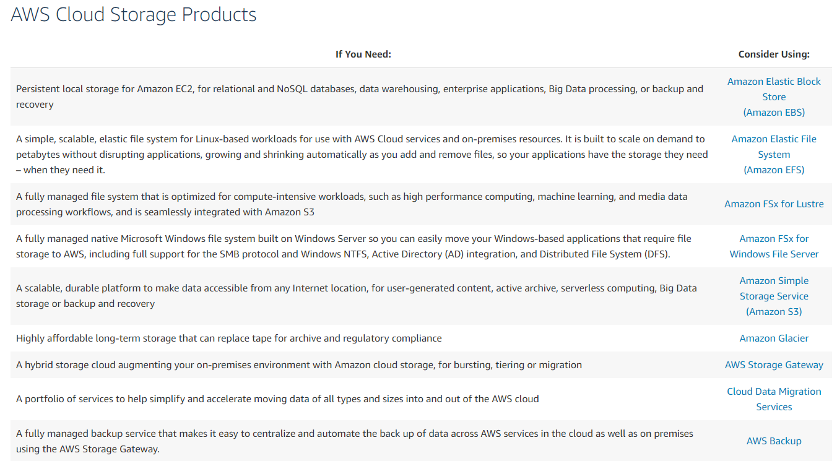
Storage
Amazon
Glacier
S3
EBS
Deployment & Administrator
App Services
Compute
Storage
Database
Networking
AWS Global Infrastructure

Slide 26
Storage
Simple Storage Service (S3)
Durable storage, any object
99.999999999% durability of object
Unlimited storage of object of any type
Up to 5TB size per object
Elastic Block Storage (EBS)
Hight performance block a storage device
mount as drive to instance
Glacier
Amazon Glacier is a storage service optimized for infrequently used data, or "cold data."
Amazon
Glacier
S3
EBS
Deployment & Administrator
App Services
Compute
Storage
Database
Networking
AWS Global Infrastructure

Slide 27

Storage
S3
Amazon S3 has a simple web services interface that you can use to store and retrieve any amount of data, at any time, from anywhere on the web. S3 provide Object-level storage.
Key Features:
Simplicity.
Durability.
Scalability.
Security.
Broad integration with other AWS services
Cloud Data Migration options
Enterprise-class Storage Management.
Notes:
Simplicity. Amazon S3 is built for simplicity, with a web-based management console, mobile app, and full REST APIs and SDKs for easy integration with third party technologies.
Durability. Amazon S3 is available in regions around the world, and includes geographic redundancy within each region as well as the option to replicate across regions. In addition, multiple versions of an object may be preserved for point-in-time recovery.
Scalability. Customers around the world depend on Amazon S3 to safeguard trillions of objects every day. Costs grow and shrink on demand, and global deployments can be done in minutes. Industries like financial services, healthcare, media, and entertainment use it to build big data, analytics, transcoding, and archive applications.
Security. Amazon S3 supports data transfer over SSL and automatic encryption of your data once it is uploaded. You can also configure bucket policies to manage object permissions and control access to your data using AWS Identity and Access Management (IAM).
Broad integration with other AWS services for security (IAM and KMS), alerting (CloudWatch, CloudTrail and Event Notifications), computing (Lambda), and database (EMR, Redshift), designed to integrate directly with Amazon S3.
Cloud Data Migration options. AWS storage includes multiple specialized methods to help you get data into and out of the cloud.
Enterprise-class Storage Management. S3 Storage Management features allow you to take a data-driven approach to storage optimization, data security, and management efficiency.

Slide 28
Amazon S3 Storage Classes
General Purpose
Amazon S3 Standard Amazon S3 Standard offers high durability, availability, and performance object storage for frequently accessed data.
Notes:
Amazon S3 Standard
Amazon S3 Standard offers high durability, availability, and performance object storage for frequently accessed data. Because it delivers low latency and high throughput, Standard is perfect for a wide variety of use cases including cloud applications, dynamic websites, content distribution, mobile and gaming applications, and big data analytics. Lifecycle management offers configurable policies to automatically migrate objects to the most appropriate storage class.
Amazon Glacier
Amazon Glacier is a secure, durable, and extremely low-cost storage service for data archiving. You can reliably store any amount of data at costs that are competitive with or cheaper than on-premises solutions. To keep costs low yet suitable for varying retrieval needs, Amazon Glacier provides three options for access to archives, from a few minutes to several hours. Amazon Glacier supports lifecycle policies for automatic migration between storage classes. Please see the Amazon Glacier page for more details.
Amazon S3 Standard - Infrequent Access
Amazon S3 Standard - Infrequent Access (Standard - IA) is an Amazon S3 storage class for data that is accessed less frequently, but requires rapid access when needed. Standard - IA offers the high durability, throughput, and low latency of Amazon S3 Standard, with a low per GB storage price and per GB retrieval fee. This combination of low cost and high performance make Standard - IA ideal for long-term storage, backups, and as a data store for disaster recovery. The Standard - IA storage class is set at the object level and can exist in the same bucket as Standard, allowing you to use lifecycle policies to automatically transition objects between storage classes without any application changes.

Slide 29
Amazon S3 Storage Classes
Unknown or changing access
Amazon S3 Intelligent-Tiering (S3 Intelligent-Tiering) — NEW
The S3 Intelligent-Tiering storage class is designed to optimize costs by automatically moving data to the most cost-effective access tier, without performance impact or operational overhead
Notes:
Amazon S3 Standard
Amazon S3 Standard offers high durability, availability, and performance object storage for frequently accessed data. Because it delivers low latency and high throughput, Standard is perfect for a wide variety of use cases including cloud applications, dynamic websites, content distribution, mobile and gaming applications, and big data analytics. Lifecycle management offers configurable policies to automatically migrate objects to the most appropriate storage class.
Amazon Glacier
Amazon Glacier is a secure, durable, and extremely low-cost storage service for data archiving. You can reliably store any amount of data at costs that are competitive with or cheaper than on-premises solutions. To keep costs low yet suitable for varying retrieval needs, Amazon Glacier provides three options for access to archives, from a few minutes to several hours. Amazon Glacier supports lifecycle policies for automatic migration between storage classes. Please see the Amazon Glacier page for more details.
Amazon S3 Standard - Infrequent Access
Amazon S3 Standard - Infrequent Access (Standard - IA) is an Amazon S3 storage class for data that is accessed less frequently, but requires rapid access when needed. Standard - IA offers the high durability, throughput, and low latency of Amazon S3 Standard, with a low per GB storage price and per GB retrieval fee. This combination of low cost and high performance make Standard - IA ideal for long-term storage, backups, and as a data store for disaster recovery. The Standard - IA storage class is set at the object level and can exist in the same bucket as Standard, allowing you to use lifecycle policies to automatically transition objects between storage classes without any application changes.

Slide 30
Amazon S3 Storage Classes
Infrequent Access
Amazon S3 Standard - Infrequent Access (Standard - IA)
S3 Standard-IA is for data that is accessed less frequently, but requires rapid access when needed. S3 Standard-IA offers the high durability, high throughput, and low latency of S3 Standard
Amazon S3 One Zone-Infrequent Access (S3 One Zone-IA)
S3 One Zone-IA stores data in a single AZ and costs 20% less than S3 Standard-IA.
Notes:
S3 One Zone-IA is ideal for customers who want a lower-cost option for infrequently accessed data but do not require the availability and resilience of S3 Standard or S3 Standard-IA. It’s a good choice for storing secondary backup copies of on-premises data or easily re-creatable data

Slide 31
Amazon S3 Storage Classes
Archive
Amazon Glacier
Amazon Glacier is a secure, durable, and extremely low-cost storage service for data archiving.
Amazon S3 Glacier Deep Archive (S3 Glacier Deep Archive) COMING SOON
Notes:
S3 Glacier Deep Archive is Amazon S3’s lowest-cost storage class and supports long-term retention and digital preservation for data that won’t be regularly accessed. It is designed for customers — particularly those in highly-regulated industries, such as the Financial Services, Healthcare, and Public Sectors — that retain data sets for 7-10 years or longer to meet regulatory compliance requirements. S3 Glacier Deep Archive can also be used for backup and disaster recovery use cases, and is a cost-effective and easy-to-manage alternative to magnetic tape systems, whether they are on-premises libraries or off-premises services.
and can be restored within 12 hours.

Slide 32
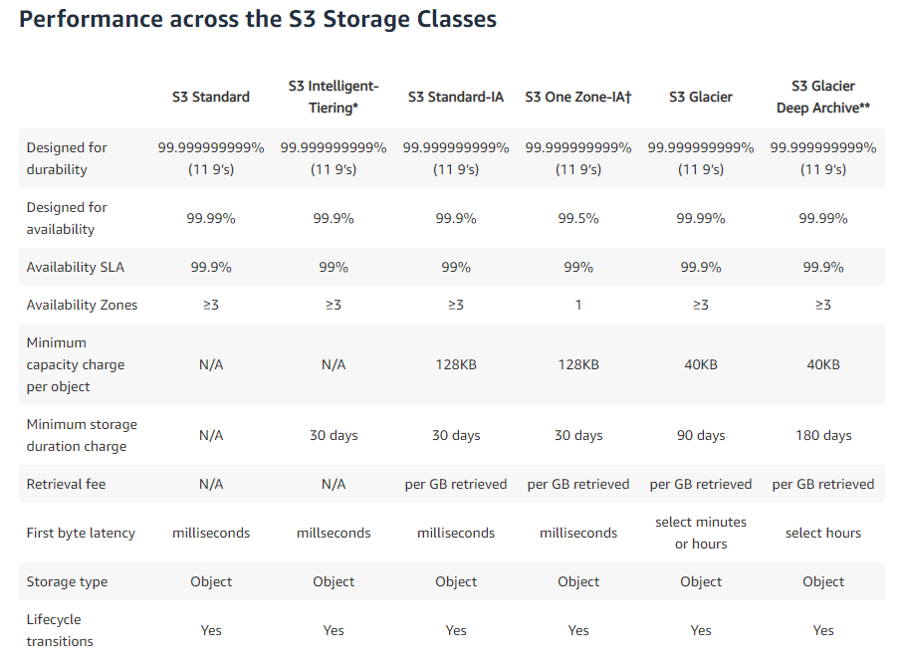

Slide 33
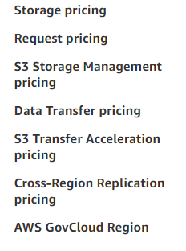
S3 Pricing Fundamental

Slide 34

Storage
EBS
Amazon Elastic Block Store (Amazon EBS) provides persistent block storage volumes for use with Amazon EC2 instances in the AWS Cloud.
Features:
High Performance Volumes
Availability
Encryption
Access Management
Snapshots
Elastic Volumes
Notes:
High Performance Volumes
Choose between SSD-backed or HDD-backed volumes that can deliver the performance you need for your most demanding applications.
Availability
Each Amazon EBS volume is designed for 99.999% availability and automatically replicates within its Availability Zone to protect your applications from component failure.
Encryption
Amazon EBS encryption provides seamless support for data-at-rest and data-in-transit between EC2 instances and EBS volumes.
Access Management
Amazon’s flexible access control policies allow you to specify who can access which EBS volumes ensuring secure access to your data.
Snapshots
Protect your data by creating point-in-time snapshots of EBS volumes, which are backed up to Amazon S3 for long-term durability.
Elastic Volumes
Dynamically increase capacity, tune performance, and change the type of live EBS volumes.

Slide 35
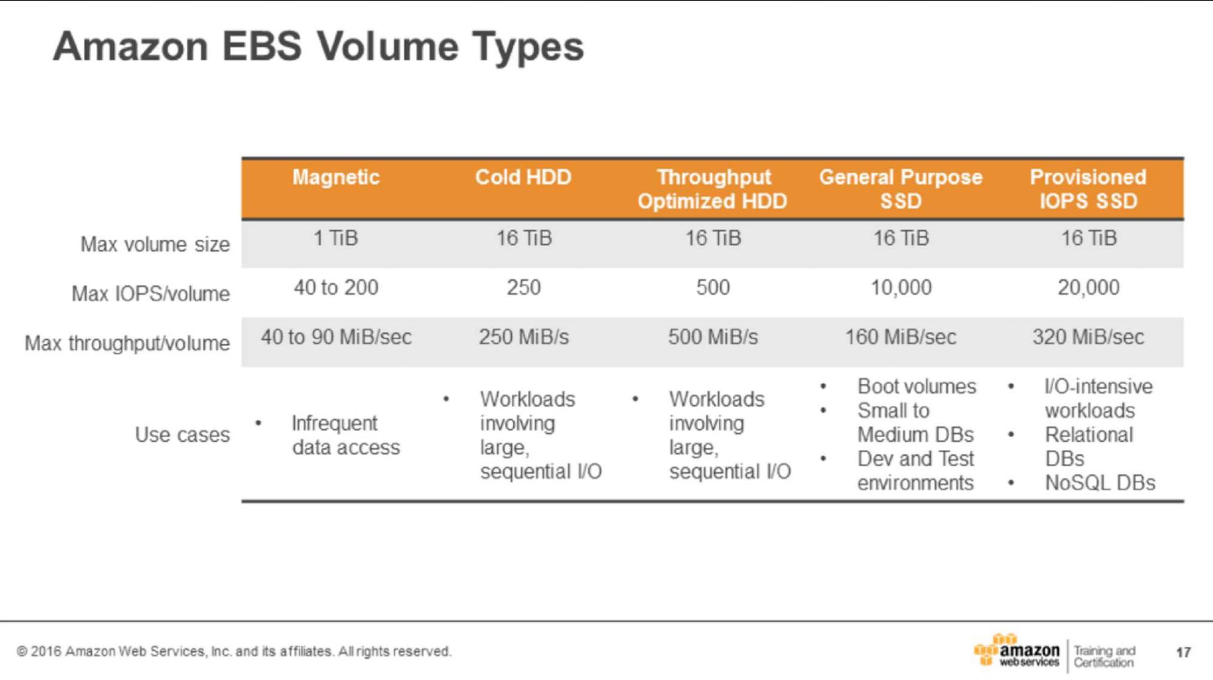

Slide 36


Database
Relation Database service
Databse-as-a-service
No need to install or manage database instances
scalable and fault tolerant configurations
DynamoDB
Provisioned throughtput NoSQL database
Fast, predictable performance
Fully distributed, fault tolerant architecture
Self-managed
Your choice of database running on EC2
Amazon
DynamoDB
Amazon RDS
Deployment & Administrator
App Services
Compute
Storage
Database
Networking
AWS Global Infrastructure

Slide 37



Application Service
Amazon SQS
Reliable, hightly scalable, queue service for storing messages
Amazon SNS
Amazon Simple Notification Service (Amazon SNS) is a web service that enables applications, end-users, and devices to instantly send and receive notifications
Amazon Cloudfront
Amazon CloudFront is a global content delivery network (CDN) service that securely delivers data, videos, applications, and APIs to your viewers with low latency and high transfer speeds
Amazon
SQS
Amazon SNS
Cloudfront
Deployment & Administrator
App Services
Compute
Storage
Database
Networking
AWS Global Infrastructure

Slide 38



Deployment & Administrator
Elastic Beanstalk
You can simply upload your code and Elastic Beanstalk automatically handles the deployment, from capacity provisioning, load balancing, auto-scaling to application health monitoring.
Cloud Formation
AWS CloudFormation gives developers and systems administrators an easy way to create and manage a collection of related AWS resources, provisioning and updating them in an orderly and predictable fashion.
Identity & Access Management
Centrally manage access and authentication of your users to your AWS resources.
Elastic Beanstalk
Cloud Formation
IAM
Deployment & Administrator
App Services
Compute
Storage
Database
Networking
AWS Global Infrastructure

Slide 39
Type of Security Credentials
Email address and password | Associate with your AWS Account (Root)
IAM User name and password | Use for access the AWS management console
Access key | Typically use with CLI and programmatic requests like API and SDKs
Multi-Factor Authentication | Extra layer of security
 | con be enable for root account and IAM user
Keypair | Used only for specific AWS services like Amazon EC2

Slide 40
AWS Shared Responsibility Model

Slide 41
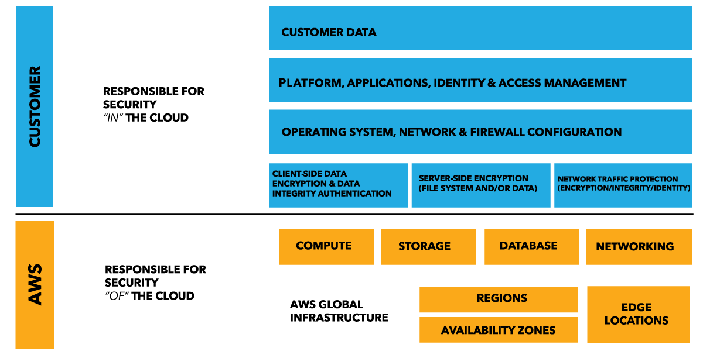
AWS Shared Responsibility Model

Slide 42
AWS Training & Certification

Slide 43



Self-paced lab
Try product, gain new skill, and get hand-on practice working AWS techonologies
https://aws.amazon.com/training/self-paced-labs/
Training
Build Technical experties to design and operate scalable, efficient applications on AWS
https://aws.amazon.com/training/
Certification
Validate your proven skills and experties with the AWS platform
https://aws.amazon.com/certification/

Slide 44
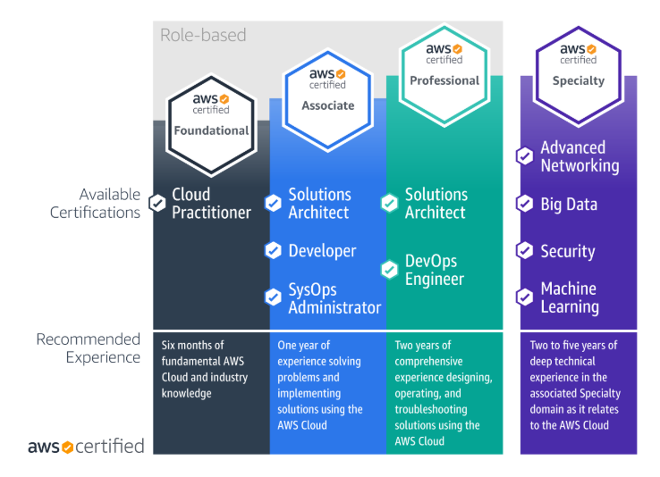

Slide 45
Getting Started With AWS

Slide 46
What are the first things to do with a new
AWS Account?
1/ Stop using your root account as soon as possible
2/ Require multi-factor authentication for access
3/ Enable AWS Cloudtrail
4/ Track change to resources with AWS Config
5/ Enable a billing report, such as the AWS cost and usage Report

Slide 47
Questions

